Slide 1
Amalgamation Discussions

Slide 2
Purpose
The meeting is being held today to discuss a proposal to amalgamate Ayr, Burford, Paris and St. George minor hockey associations
A new Hockey entity would be formed and would play at a Single A level-(To be confirmed by OMHA)
Local League and development programming would continue in each community under their own name—for example Burford Minor Hockey would continue locally.

Slide 3
Why is the change being considered
Offer players the opportunity to play at a level that is appropriate for their capability and in their communities
Offer players the opportunity to play with players their own age
Registration numbers at some of the associations are in decline with players moving to other centres to play at higher levels and overall hockey enrollment decreasing.
65-80 less players prior to Covid. 24 players playing at a higher level else where in 2023/24.
Increase opportunities for player development at all positions and skill levels
Larger pool of parent/guardian volunteers to assist in delivering programming
Control our own destiny and develop a minor Hockey association that will celebrate the tradition of each community's local association while forming a new hockey entity that will compete a higher level than currently offered.

Slide 4
Current State
Burford Local League Teams play in Intertown Local League
Burford Rep C teams play in Southern Counties
Development programs start with U5 Lil Howlers Hockey Fundamentals and continue with a U7 program divided into Jr IP and Sr IP U6/U7
League play begins at U8.
League play is governed by Hockey Canada Pathways

Slide 5
Current INTERTOWN Local League

Slide 6
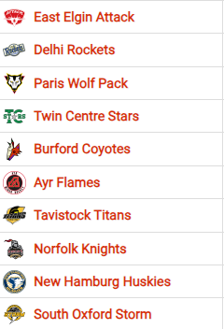
Current Southern Counties League
**Norfolk, South Oxford, New Hamburg enter B teams(AE Teams)**

Slide 7
Recent Mergers
Aylmer and Belmont=East Elgin Attack---B Centre
Ingersoll and Tillsonburg=South Oxford Storm---A Centre
Simcoe, Waterford, Port Dover= Norfolk Knights---A Centre
Caledonia, Hagersville, Dunnville, Cayuga=Haldimand River Kings---A

Slide 8
Other Merger Discussions
Delhi, Norwich and Langton have discussions on-going

Slide 9
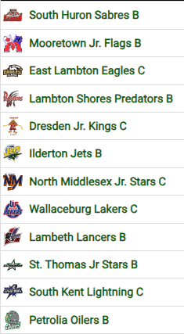
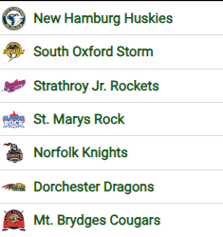
Other Leagues-
B Division
A Division
Shamrock Offers A, B Divisions

Slide 10
Shamrock League
Newly formed A Division
Mount Brydges, Dorchester, St Marys, South Oxford, all moved to Single A this season and to this new league by OMHA
Likely destination for a merged association
League to add St. Thomas next season.
Other A centres likely to join as other centres merge and OMHA aligns leagues geographically

Slide 11
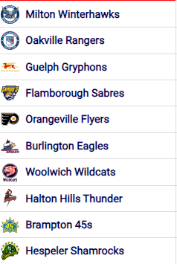
Other Leagues
Tri County Offers A

Slide 12
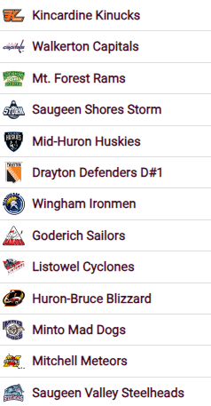
Other Leagues
Western Ontario Athletic Alliance

Slide 13
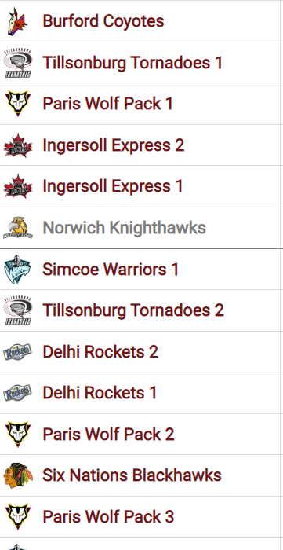
Other Leagues
InNer Town Local League

Slide 14
Proposal for consideration
Form a new Hockey Centre temporarily called Brant- Waterloo; a merger of Ayr, Burford, Paris and St. George.
The current board members of each association will appoint a board that will govern the new association and put together by-laws and rules for the new association. The initial board will have equal representation from each association.
Burford Minor Hockey would continue to exist under the umbrella of this new association and would continue to run locally focused development and team programming. A committee of the board would be established run the Burford Minor Hockey program.
OMHA will designate league and level of play of the new association.

Slide 15
Categories Of Merged Association—Representative Hockey
U10 A
U11 A
U12 A
U13 A
U14 A
U15 A
U16 A
U18 A
U21 A
*U8 MD
*U9 MD
U11 B
U13 B
U15 B
U18 B
U5
U7
U8 LL
U9 LL
U11LL
U13 LL
U15 LL
U18 LL
Teams to Play in Southern Counties League
Teams to Play in Intertown Local League As Burford Minor Hockey
Likely to play in the Shamrock A league

Slide 16
Team Comparison
Current | League | Hockey Entity | Proposed | League | Hockey Entity
Fundamental | Exhibition | Burford Minor Hockey | Fundamentals | Exhibition | Burford Minor Hockey
U7 Jr IP | Exhibition | Burford Minor Hockey | U7 Jr IP | Exhibition | Burford Minor Hockey
U7 Sr IP | Exhibition | Burford Minor Hockey | U7 Sr IP | Exhibition | Burford Minor Hockey
U8 MD | **Southern Counties | Burford Minor Hockey | U8 MD | **Southern Counties | Burford Minor Hockey
U9 MD | **Southern Counties | Burford Minor Hockey | U9 MD | **Southern Counties | Burford Minor Hockey
 |  |  | U10 A | Shamrock | New Association
U11 C | Southern Counties | Burford Minor Hockey | U11 A | Shamrock | New Association
 |  |  | U11 B | Southern Counties | New Association
U11 LL | Intertown | Burford Minor Hockey | U11 LL | Intertown | Burford Minor Hockey
 |  |  | U12 A | Shamrock | New Association
U13 B | Southern Counties | Burford Minor Hockey | U13 A | Shamrock | New Association
 |  |  | U13 B | Southern Counties | New Association
U13LL | Intertown | Burford Minor Hockey | U13 LL | Intertown | Burford Minor Hockey
 |  |  | U14 A | Shamrock | New Association
U15 C | Southern Counties | Burford Minor Hockey | U15 A | Shamrock | New Association
 |  |  | U15 B | Southern Counties | New Association
U15LL | Intertown | Burford Minor Hockey | U15 LL | Intertown | Burford Minor Hockey
 |  |  | U16 A | Shamrock | New Association
U18 C | Southern Counties | Burford Minor Hockey | U18 A | Shamrock | New Association
 |  |  | U18 B | Southern Counties | New Association
U18 LL | Intertown | Burford Minor Hockey | U18 LL | Intertown | Burford Minor Hockey
U21 LL | Proposed | Burford Minor Hockey | U21 | Shamrock | New Association

Slide 17
Next Steps
Burford Minor Hockey to hold a membership vote on Sat November 04th
Ayr, Paris and St. George will also hold votes.
If memberships of the 4 Association vote to merge the new Association will be formed.

Slide 18
Status Quo
If the membership decides to not move forward with the merger;
We will remain with the Southern Counties league
Maintain status quo with our Local League, player development programs
Players will have increased opportunity to move to other centres as NRP(Non Resident Player) regulations evolve to align with the OMHA directive to give players an opportunity to play at the highest level they can achieve.
Southern Counties as a league will evolve—if not enough teams are available to sustain the league OMHA will adjust league structures and Burford would be placed in another league or a realigned Southern Counties.

Slide 19
The Big Picture
NO CHANGES TO LOCAL LEAGUES OR WHERE AND WHO THEY PLAY
Local League Ice time stays the same
REP will only Merge to Higher Group Alignment
Burford Minor Hockey’s Tradition of Home Town Local Hockey will remain
More Development
More Rep Opportunities
Rep Opportunities at Age Aligned Programing

Slide 20
Discussion and Questions

